Slide 1



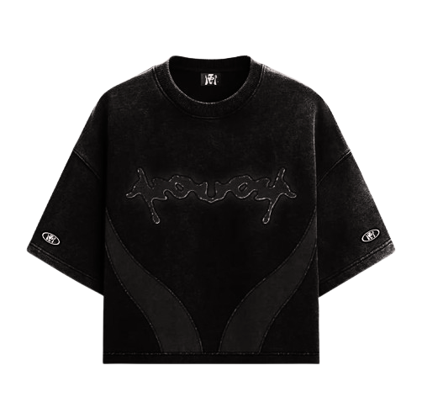
PROJECT PRESENTATION
PRASO CLOTHING
A Modern Clothing Brand with Personalized Shopping Experience
Presented By:
Jay Patel – B031
Raj Patel – B032
In the Guidance Of:
Mrs. Rupali Pawar

Slide 2

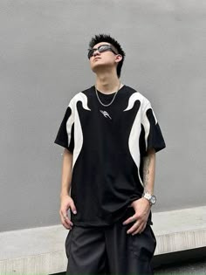

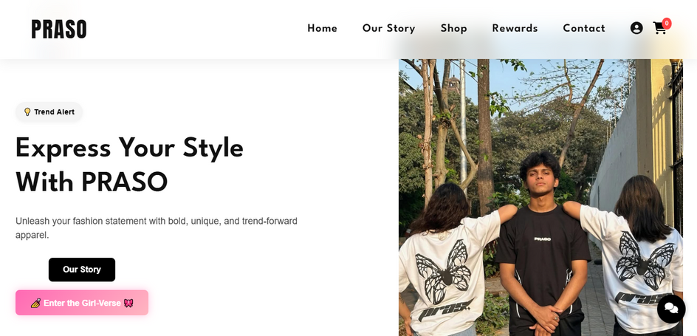




MOTIVE OF THE PROJECT
PRASO was initially operating only through Instagram, where we helped design their T-shirt collections.
As their designs started gaining attention, the need to scale and reach a wider audience became clear.

Slide 3

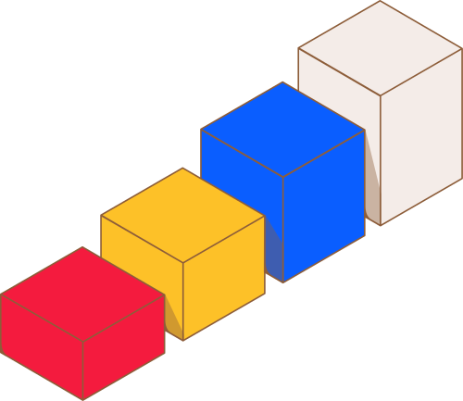



WHAT WE LEARNED
In Semester 1, We built a static single-page website. It gave us a foundation in basic HTML, CSS, and layout structure.
▪️ With this project, We moved a step ahead by:
→ Working in a team for the first time on a real brand
→ Understanding project management, task distribution & deadlines
→ Learning how to communicate and collaborate effectively
▪️ We realized how different it feels to work on a live project that will actually be used by people.

Slide 4

WHAT WE LEARNED
Implemented multiple backend features like:
→ User Authentication
→ Cart System with Context
→ User Profile Handling
▪️ Integrated animations and effects using Framer Motion & CSS
▪️ Learned how to maintain code structure in a team project and manage version control
▪️ Gained confidence in building real-world web apps beyond just static pages
Task Managements
Backend Storage
Notion
Backend
Firebase

Slide 5
Features Of Praso Clothing
Home Page
Shop
1
2
Huge Product Catalog and designs to choose from.
Hero section, countdown, and AI chatbot.
Rewards & Contact
About Us
4
3
Founders’ story, reviews, and trust-building content.
Daily bonuses, discounts, and responsive support.

Slide 6


Challenges We Faced
Design Balance
User Engagement
Blending vibrant aesthetics with usability required iteration.
Making rewards exciting but not overwhelming.
Time Pressure
Technical Hurdles
Delivering features like cart and rewards under tight deadlines.
AI chatbot integration and backend user storage.

Slide 7


Crafting and Code
1
UI Designing
Figma and Adobe XD
2
Frontend
HTML, CSS, and JavaScript for structure and style.
3
Backend
Implemented Firebase for user and inventory management
Payment gateway

Slide 8
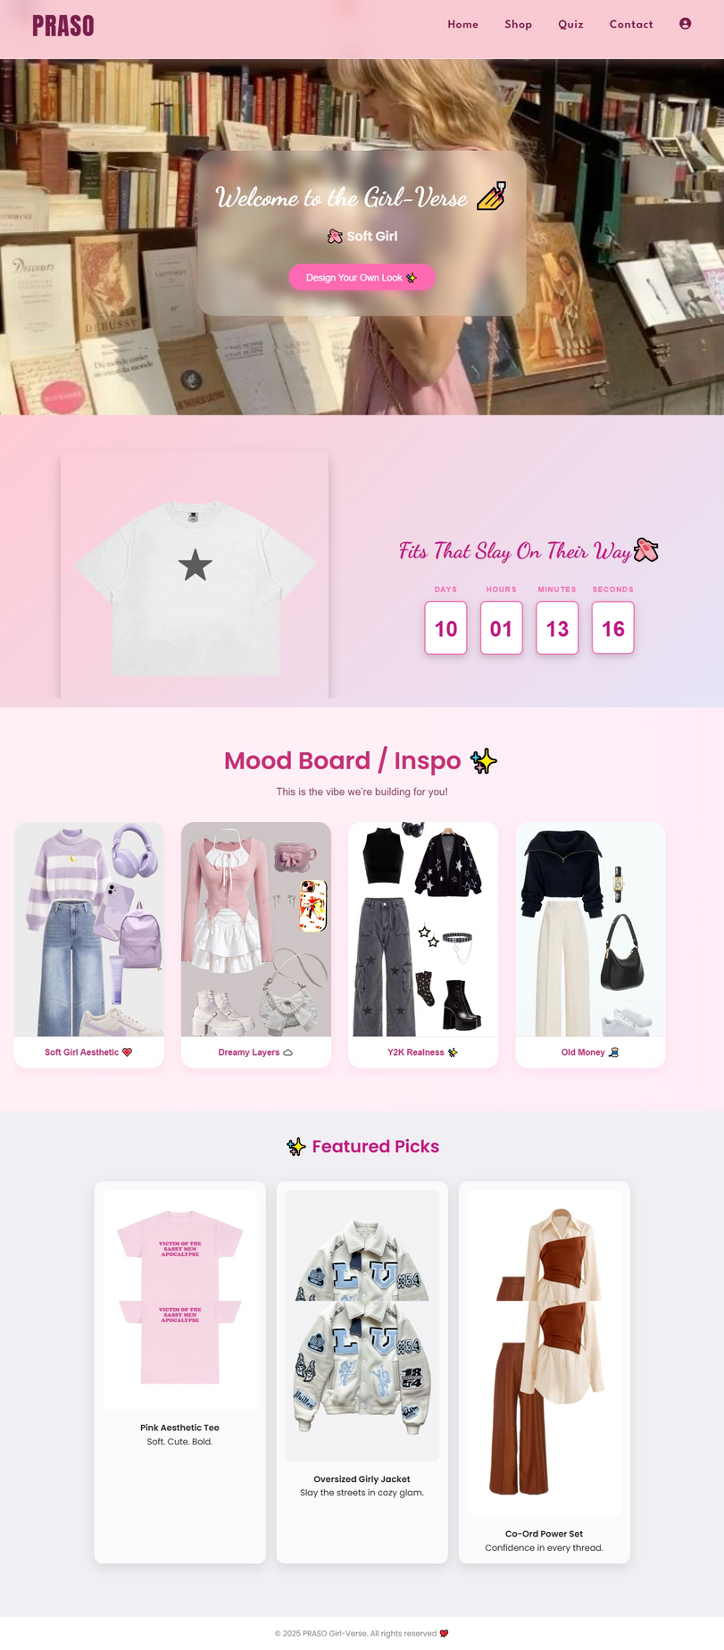
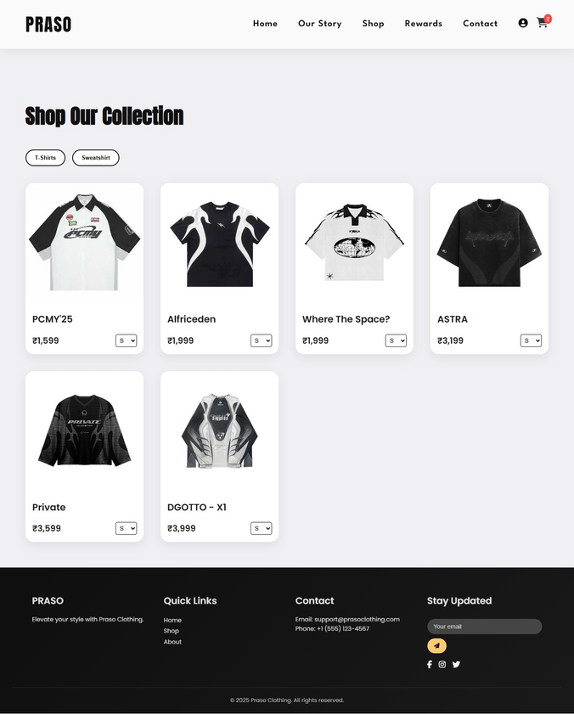
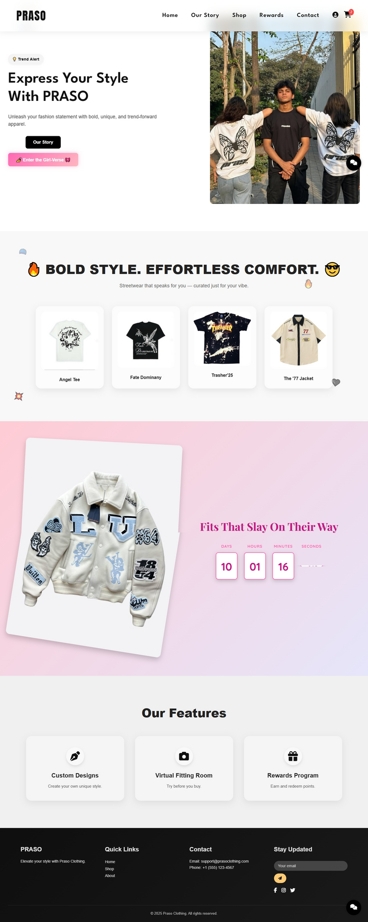
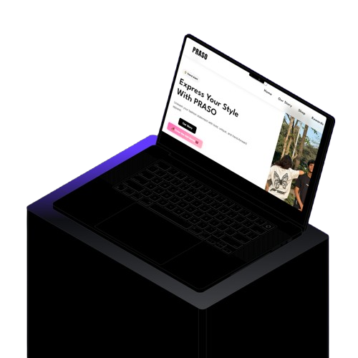
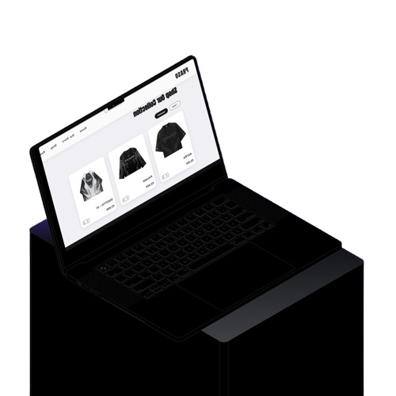
Praso in Pixels

Slide 9

Future Scope
Introduce AR try-on features for virtual fitting.
Expand product lines and add exclusive drops for loyal users
Enhance AI chatbot with advanced styling algorithms
Scale rewards with tiered loyalty programs and community-driven campaigns

Slide 10

Conclusion
1.
2.
3.
The Praso journey was an amazing adventure that taught us to be creative, strong, and focused on our users.
We learned how to work as a team, solve problems, and make things users love.
We built a fun website that helps Gen Z show their unique style.

Slide 11





THANK YOU :)

